Slide 1
CLASSIFICATION OF WHITE BLOOD CELLS WITH DEEP LEARNING
Shanzida Jahan Siddique
BIFX546

Slide 2
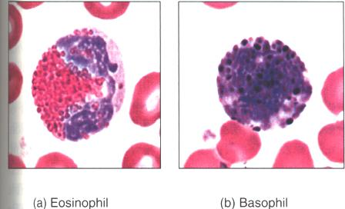
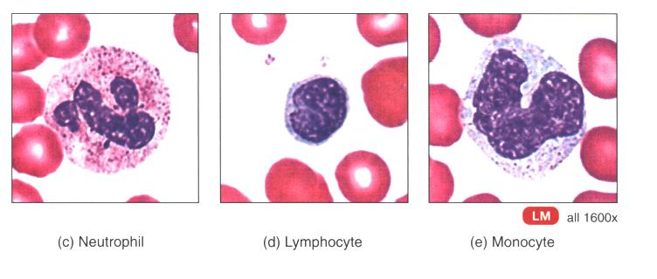
White Blood Cells and Their Types
WBC: mobile units of the body's protective system.
Normal count is 4000-11,000 /µL
Types:
Granulocytes (Polymorphnuclear or "polys"):
Neutrophils 60 %
Eosinophils 2 %
Basophils 0.4 %
Agranulocytes (mononuclear):
Lymphocytes 30 %
Monocytes 5 %

Slide 3
Why White Blood Cells Are Important
Many diseases such as haemophilia, blood clots, blood cancer etc. occur due to a blood disorder.
The diagnosis of these diseases involves to identify and characterize the patient's blood samples.
The doctor usually looks for :
The total number of White Blood Cells (WBCs) in the bloodstream.
The number of Neutrophils, Lymphocytes, Basophils, and Eosinophils (all types of WBCs) in the cell. This is known as a differentiated blood cell count.
Leukemia patients see far more Lymphocytes in their blood. Image Source: MedGurus.org

Slide 4
How WBCs Count Currently
There are two main ways to count the different types of WBCs in blood stream:
the automated way
the manual way.

Slide 5
The Automated Way of WBCs Count
This device invented in the 1950s known as a Coulter Counter.
It counts and classifies blood cells by passing them through a channel and
measuring the change in impedance.
Image source: Wikipedia.
More recently, Laser Flow Cytometers have emerged as an improved alternative to Coulter Counters.
These devices shine a laser across a channel and measure how the light from the laser is refracted as cells pass through
Based on the refraction of light, the device aims to classify the given cell.
Image source: Wikipedia.

Slide 6
The Manual Way: Inspecting a Sample Under a Microscope
A sample of blood is placed under a microscope and a pathologist manually counts the number of cells in each frame.
The total count is then extrapolated by assuming that the distribution is uniform across the entire blood sample and multiplying up.
A pathologist examining a blood sample manually.
Image source: wisegeek.com

Slide 7
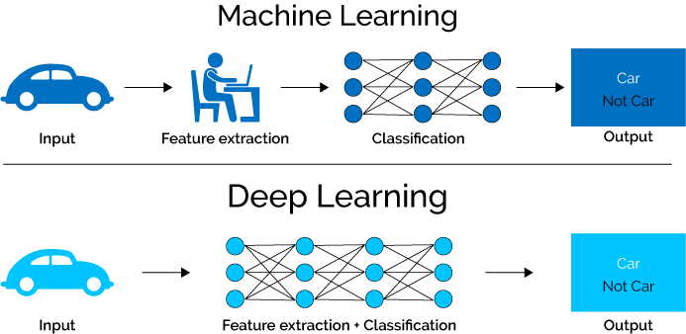
Advantages of Machine Learning/Deep Learning Over these Techniques
Both Coulter Counters and Laser Flow Cytometers cost in the tens of thousands of dollars; and manual techniques is time consuming, however ,machine learning
requires far cheaper equipment.
provides results instantly unlike the previous methods.
it can get better over time as we classify and count more and more blood cells and increase our dataset sizes.
Moreover, since it is software based, we can continuously update it over and provide consumers an experience that continually improve.
https://www.xenonstack.com/blog/static/public/uploads/media/machine-learning-vs-deep-learning.png

Slide 8
A Deep Learning Based Solution
Problem: Given a stained image of a white blood cell, classify it as either eosinophil, lymphocyte, monocyte, neutrophil.
https://colab.research.google.com/drive/1CeyaMoFq-8QorId_whsMXHLRyw8fJDA3#scrollTo=n3SwXwsm1jaQ

Slide 9
Summary
Used a simple deep learning methods to classify the white blood cells and got an accuracy of 75.5% just based on image level data. This has proved that how promising Deep Learning techniques are in the field of cell imaging and classification.
We can use such techniques in not just datasets of WBCs but a wide variety of other cells such as platelets, sickle cells, and even tumor cells.
With this software-first approach to morphology, we can apply Machine Learning to healthcare in a meaningful, valuable way.
Increased accessibility to high quality, quantitative assessments.
Lower costs and better patient outcomes.

Slide 10
Thank you

